Slide 1
Guided Capstone Project Presentation
The Pricing Strategy of Big Mountain Ski Resort Tickets
Mojtaba Ghasemi
June 2023

Slide 2
Problem Identification
Big Mountain Resort (BMR) uses data analysis to improve its ticket pricing strategy and boost revenue.
The main goal is to find the ideal ticket price and assess the effects of the potential changes.
Within the next six months, practical suggestions will be given for execution before the upcoming ski season.
Success will be measured by how the recommended ticket pricing strategy maximizes revenue without affecting the current annual visitor count of 350,000.
The suggested changes should effectively control costs, particularly the new chair lift's operational expenses ($1,540,000), while maintaining or improving current service standards.
We received a dataset that includes 330 national ski resorts across the United States including BMR.

Slide 3
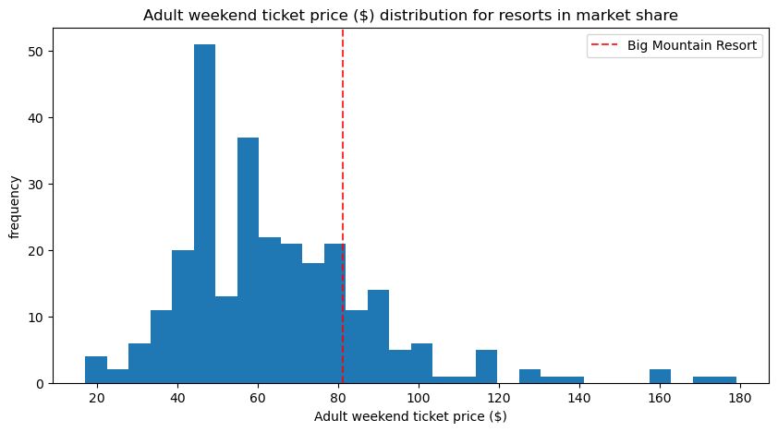
Modeling Results and Analysis
After conducting an EDA, we found no discernible patterns linking state-related data to ticket prices. As a result, we have decided to treat all states equally.
The four most influential factors affecting ticket prices are: "fastQuads", "Runs", "Snow Making_ac", and "vertical_drop".
BMR's ticket prices do not reflect the superior amenities compared to other ski resorts in the United States.
Based on the initial model, which is the Random Forest, there is a proposed increase in ticket prices from $81 to $91 (based on the price model predicted and the MAE). This increase could generate an additional $17.5 million in revenue, considering around 350,000 visitors purchase 5 passes annually.

Slide 4
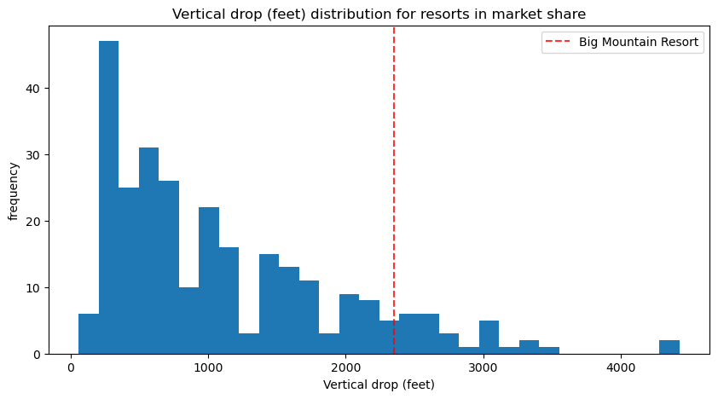
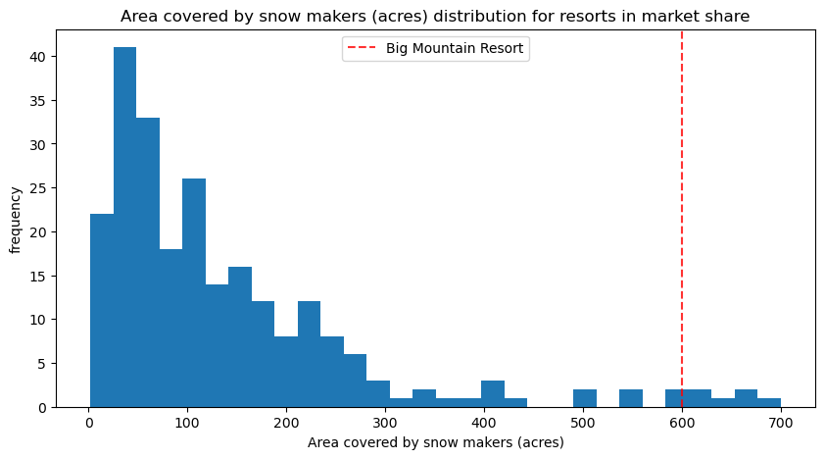
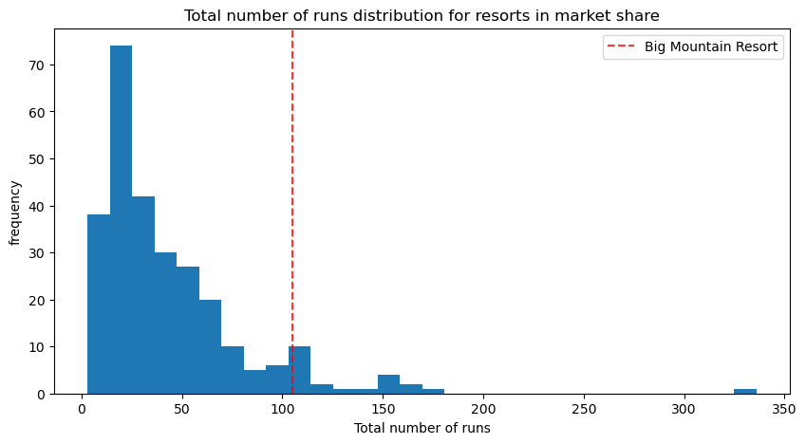
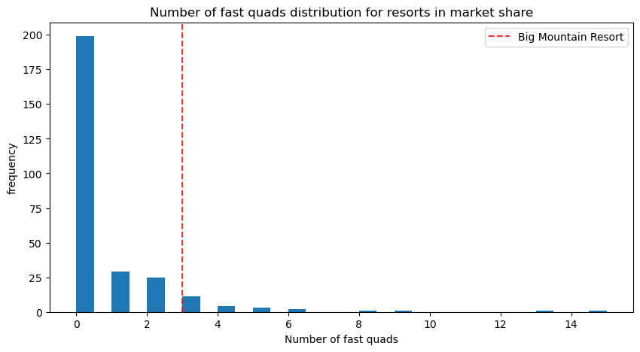
Modeling Results and Analysis
Comparison of Blue Mountain Resort amenities (dashed red line) with other resorts

Slide 5
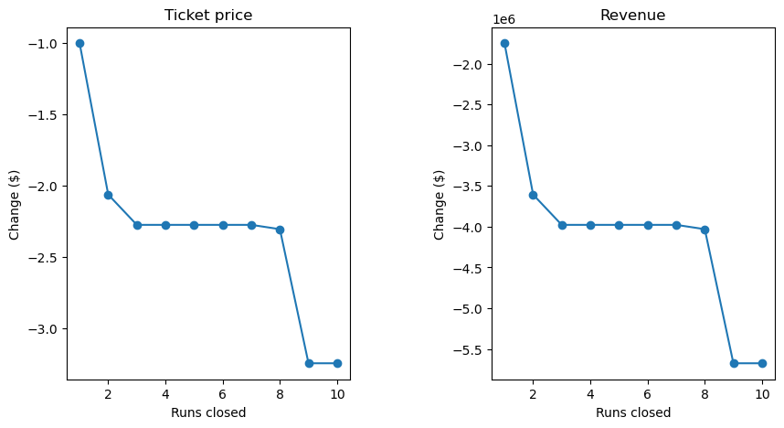
Recommendation and Conclusion
We recommend the following based on the scenarios narrowed down by the management:
Close runs
The model revealed that closing one run has no effect. However, closing 2 or 3 dramatically reduces ticket price support and revenue. With 3 closures, BMR might as well close up to 7 runs without additional ticket price loss, while 8 or more closures significantly decrease revenue.
Add vertical drop
A potential plan for BMR involves extending a run by 150 ft and installing a new chair lift without increasing snow-making coverage. This could allow BMR to raise ticket prices by $1.45, leading to an estimated increase of $2,55 in revenue for the season.

Slide 6
Recommendation and Conclusion
- Our model and analysis can be used by business leaders for the following:
Pricing Strategies
Market Analysis
Customer Classifications
- To make the model more accessible to business analysts in the future, a user-friendly interface can be created. This could be in the form of a web-application or a tool integrated into an existing business intelligence platform.

